Slide 1
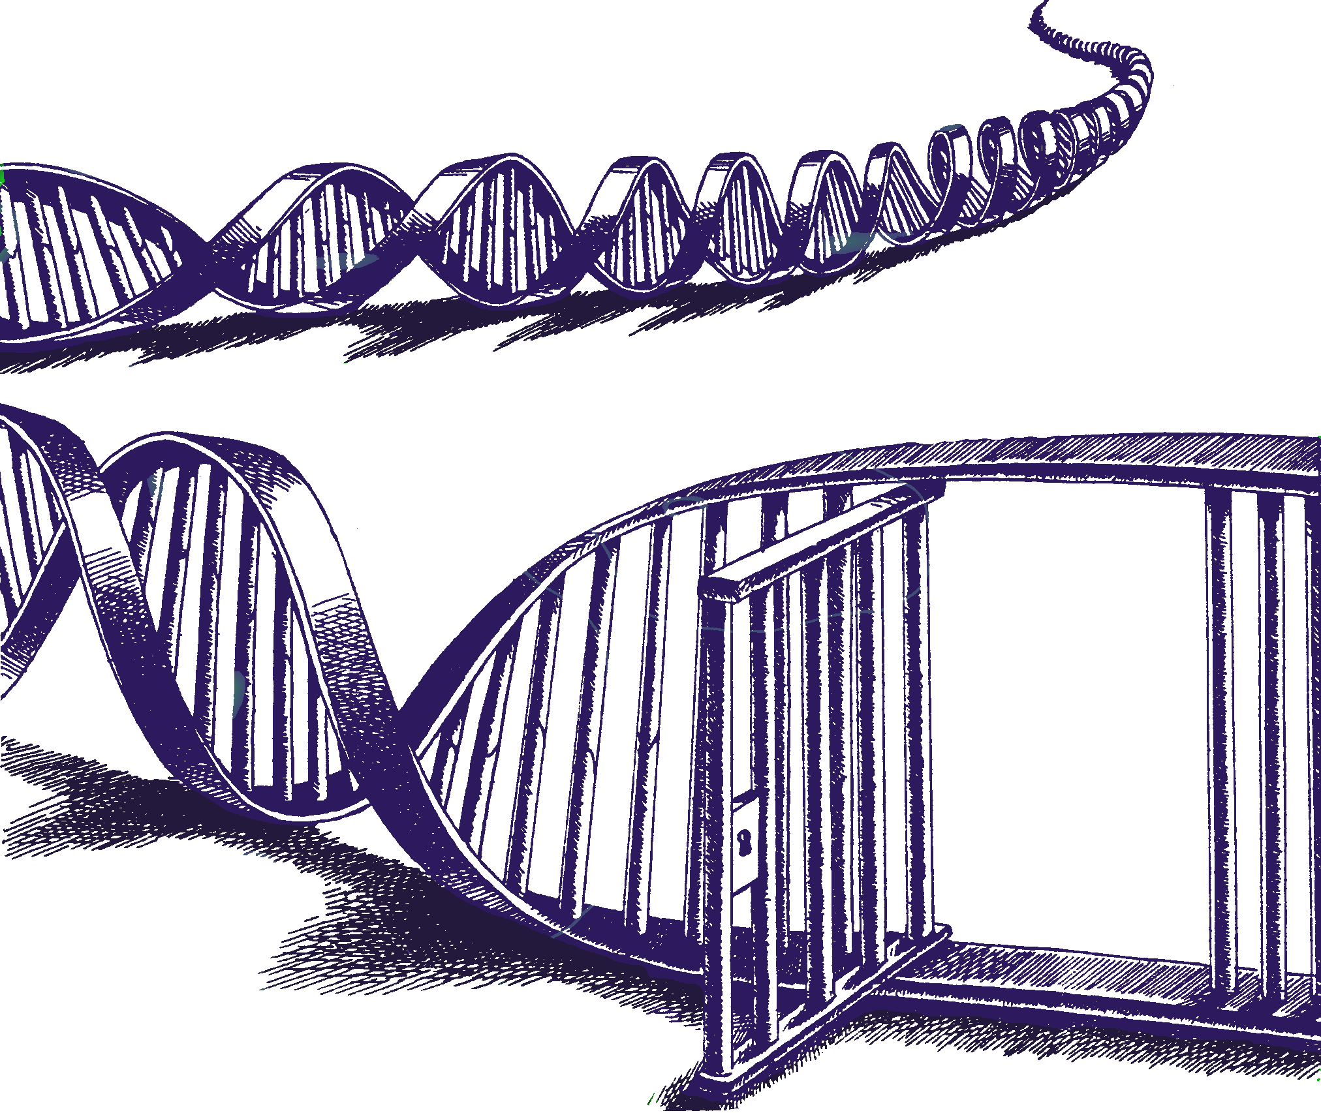
A fool’s errand – Assigning the number of mixture contributors
Lessons from Mixture Solution™ program development
Charles Brenner, Ph.D.
Purveyor of forensic mathematics, DNA∙VIEW®,
UC Berkeley Visiting Scholar
charles@dna-view.com +1 510 798 7139
http://dna-view.com
1:55-2:10 17 Feb 2017 B188
Notes:
Disclosures – DNA-VIEW is the name of my software and (informally) of my business.
Mixture Solution is a part of it that will get some mention in this generally academic talk.
In accord with the AAFS request, in case I happen to refer to competing programs STRmix/TrueAllele I should let you know that I have no stake.
Bode, a long-time user of my software, will be mentioned.

Slide 2
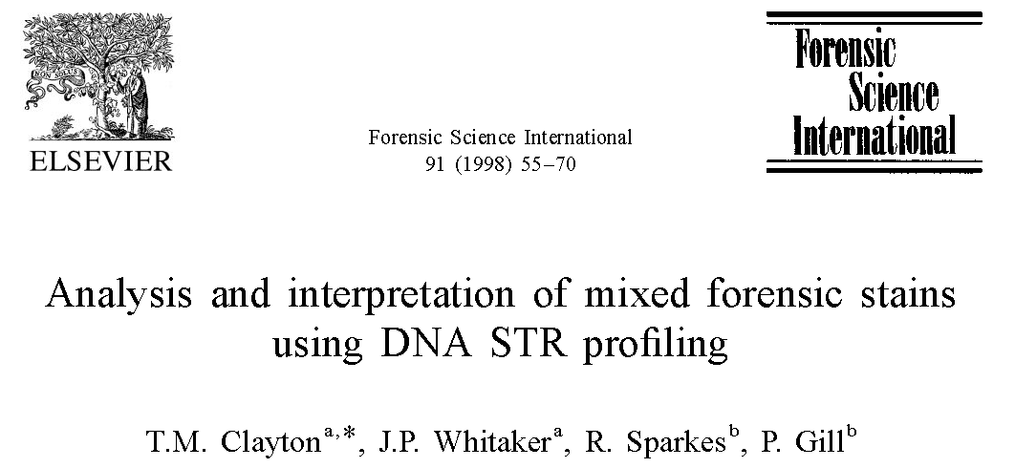
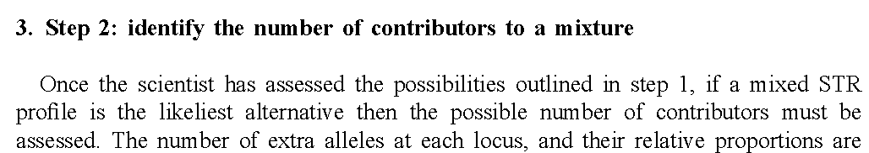
“Decide # contributors”
Clayton, … Gill 1998
the possible number of contributors must be assessed

Slide 3
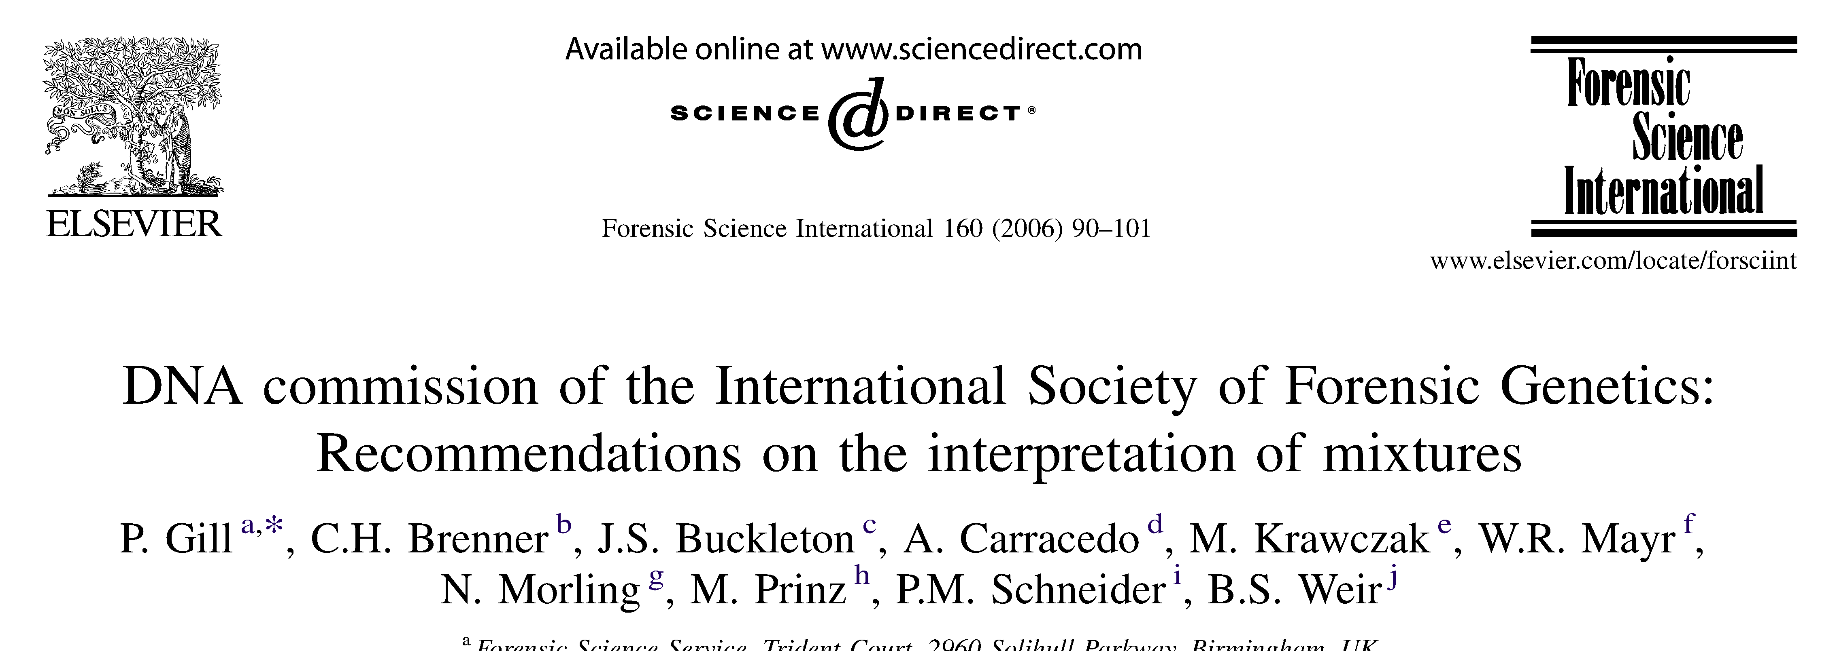
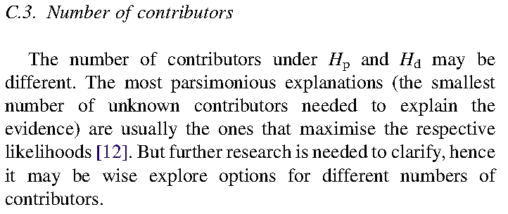
Differing #’s?
Gill, Brenner, Buckleton … 2006
The number of contributors under H_{p} and H_{d} may be different.

Slide 4
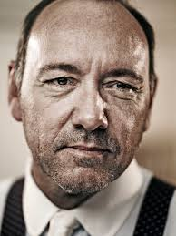

Differing #’s?
The number of contributors under H_{p} and H_{d} may be different.
Allow defense to choose its defense H_{d} in its self-interest.
H_{p} = suspect
Allow prosecution to choose H_{p} in its self-interest.
H_{d} = 2 unknowns

Slide 5
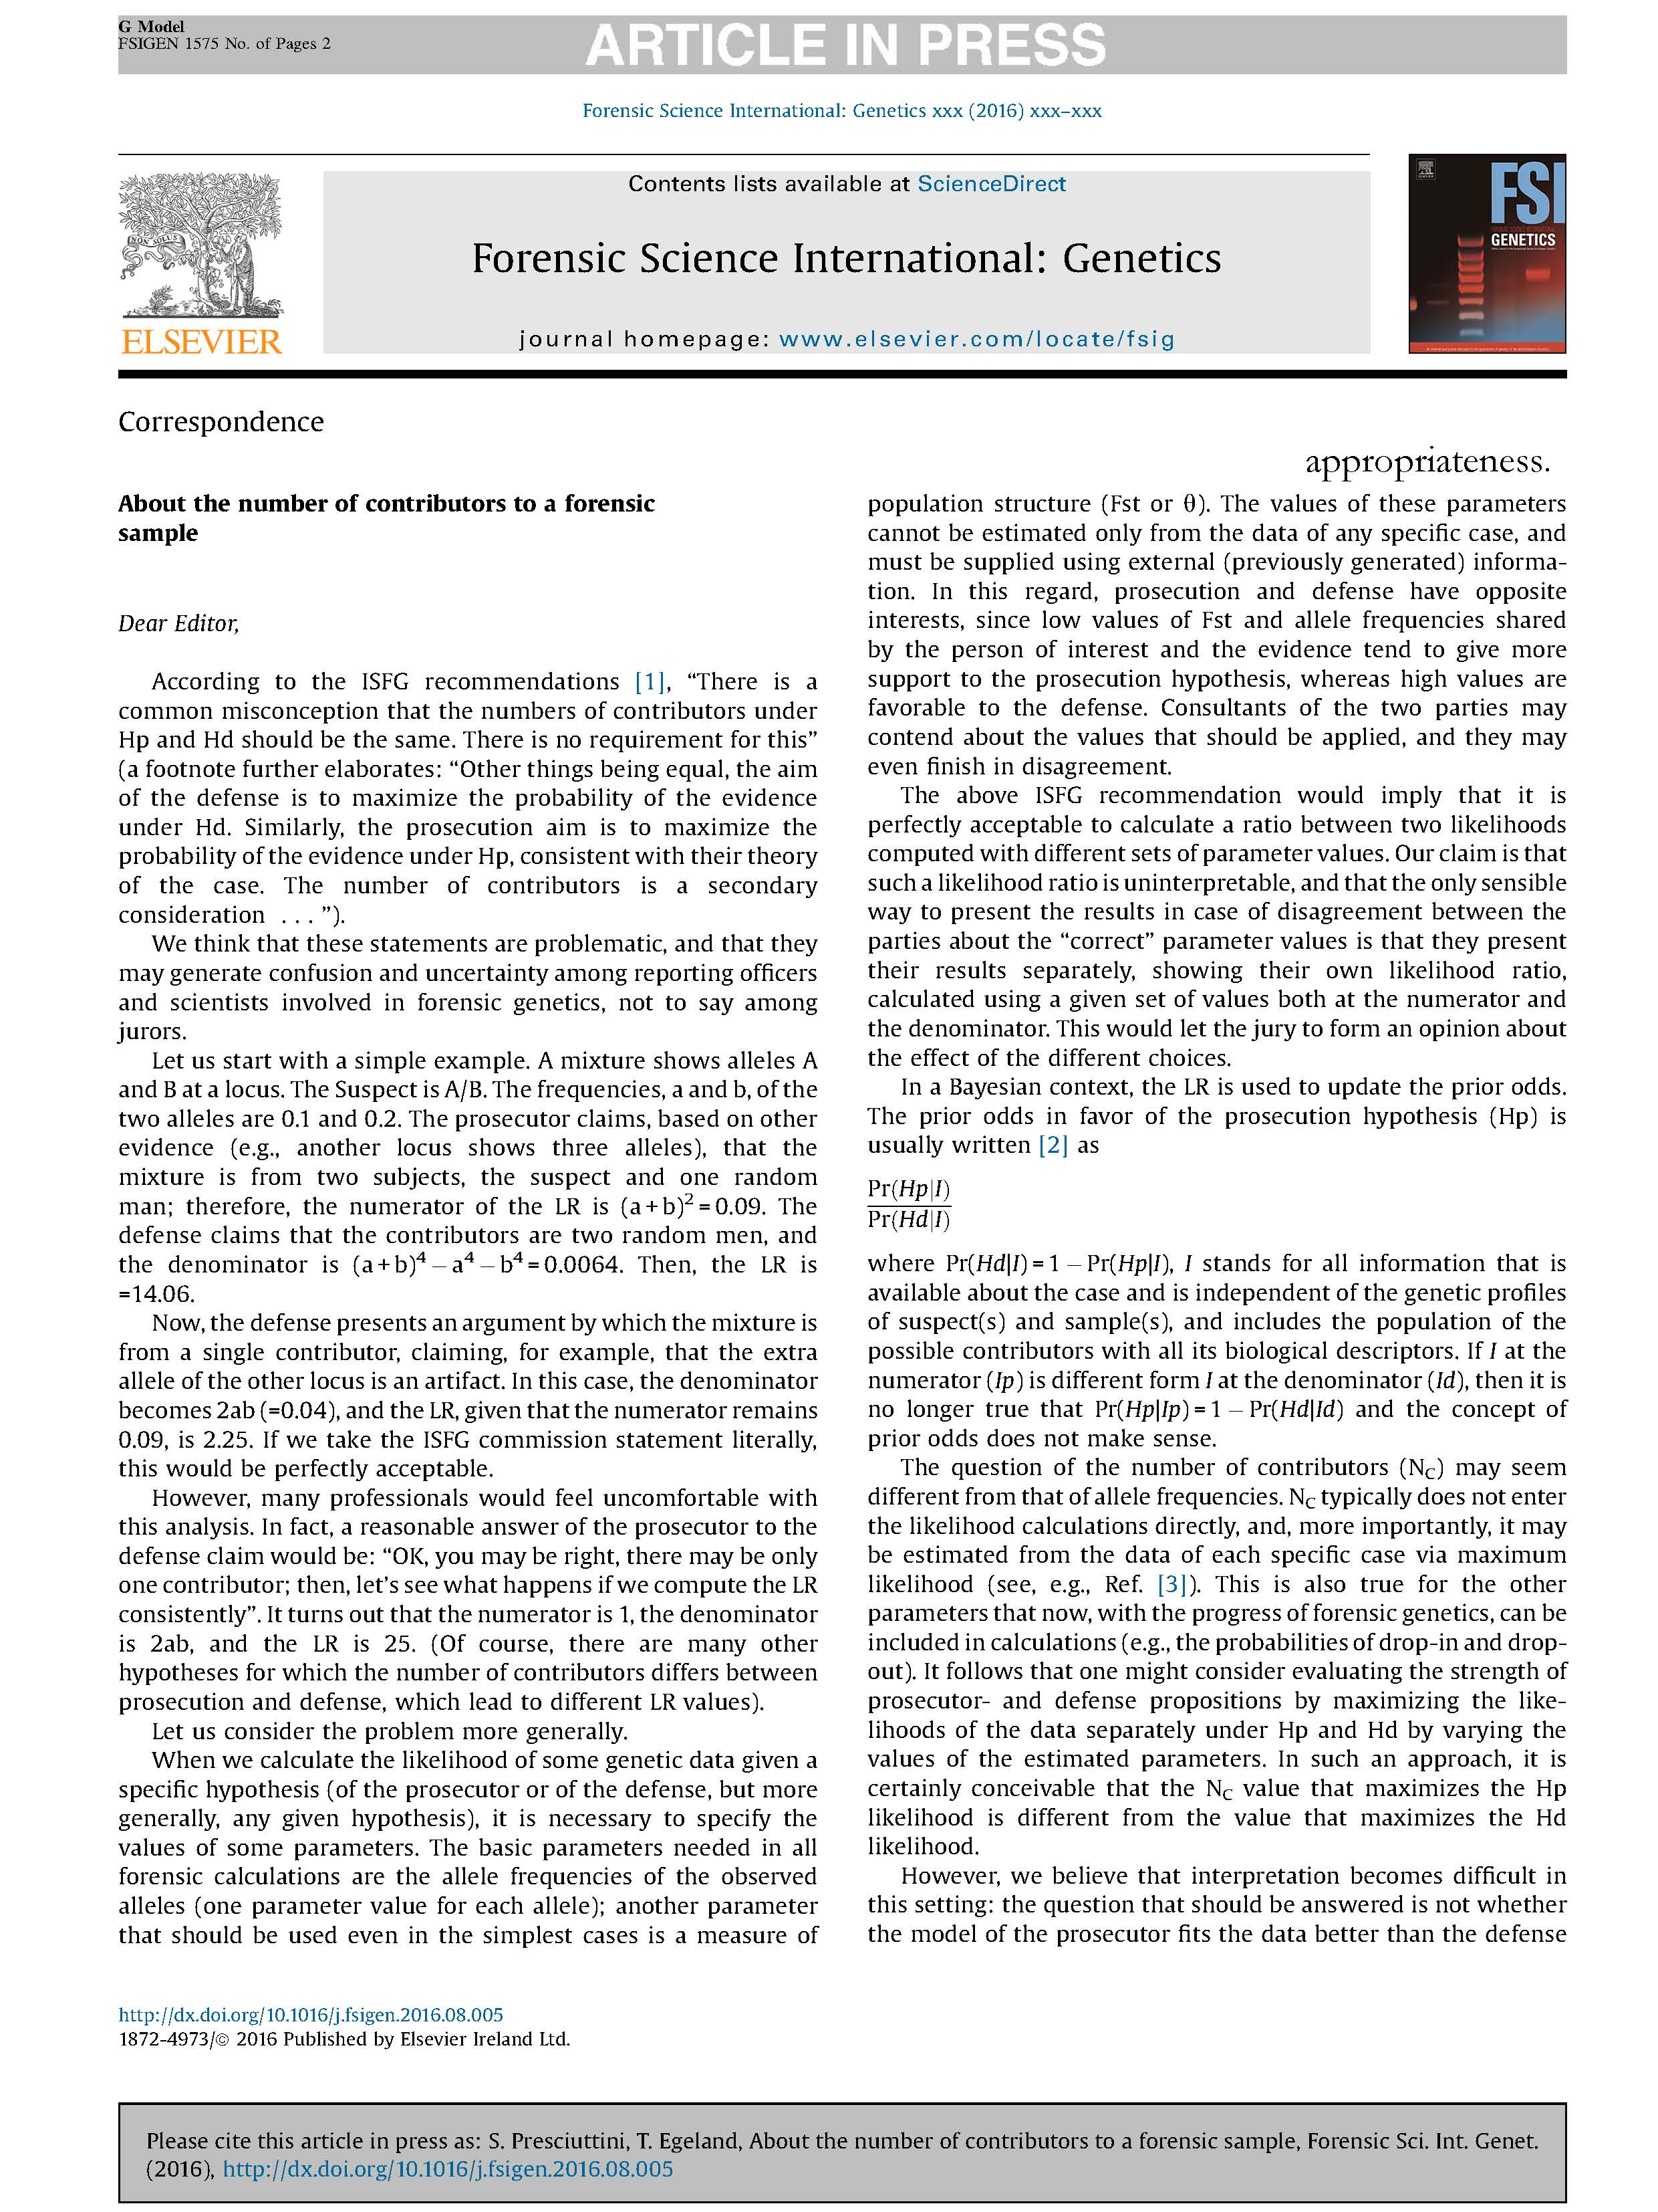
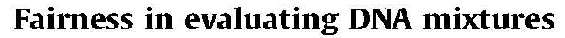
Differing #’s? – recent letters
Presciuttini & Egeland Dec 2016 ..
Assert (reasonably) that Hp & Hd should both incorporate the available information.
Assume (unreasonably) “# of contributors” is “available information.”
Conclude (circularly) that # must be same for Hp & Hd.
They further conclude: The question that should be answered is
not whether the model of the prosecutor fits the data better than the defense model;
the question is if a person of interest fits the data better than a random person, all other circumstances being equal.
Brenner Jan 2017 response:

Slide 6
# contributors – what’s your guess?
Mixture Solution™’s guess
Maybe 3
Notes:
LR (3 unk / 4 unk) = 7.
Next slide shows victim & boyfriend K1,K2. Omit “under the hood” at least for now.

Slide 7
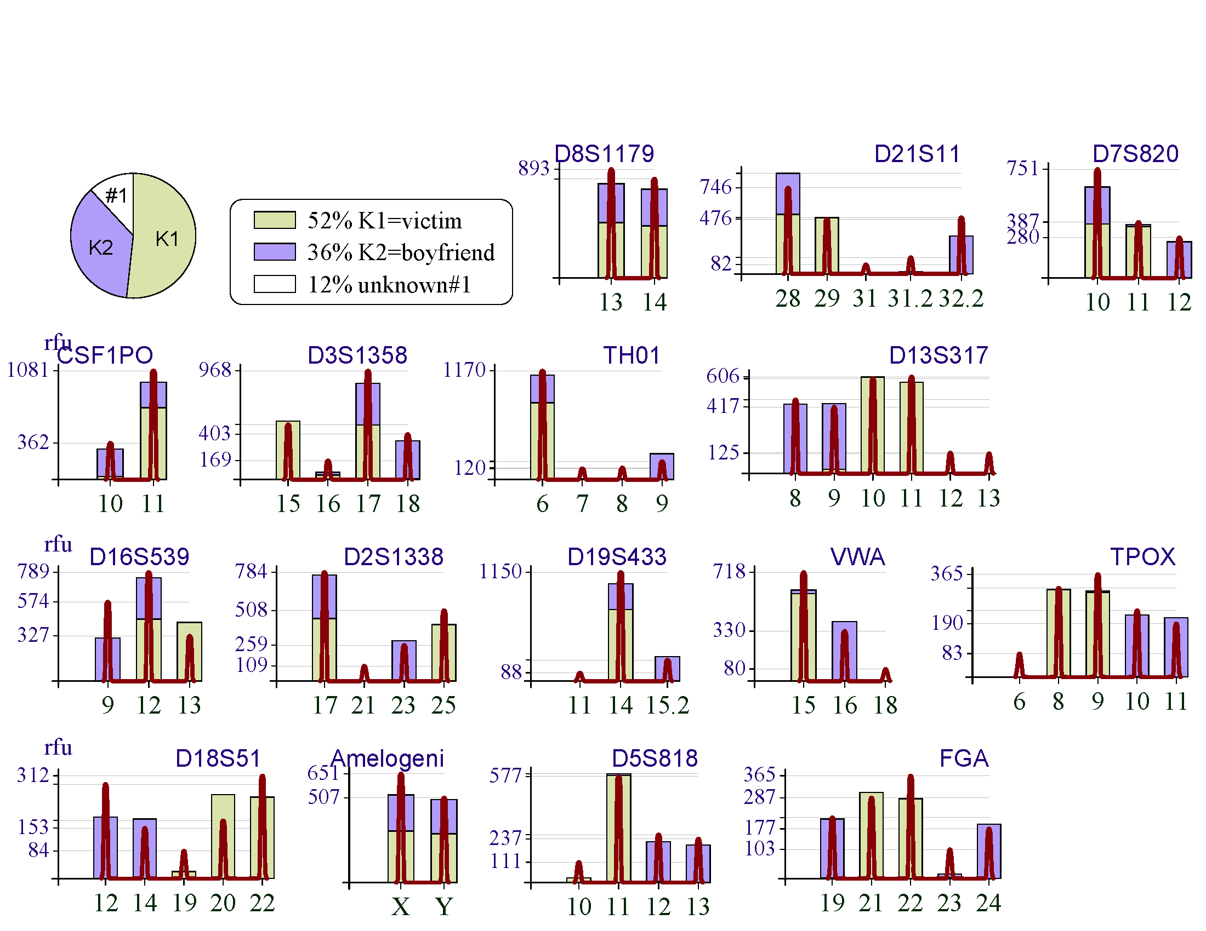
S defense claims K1,K2 in mixture, not S
3 contributors is right
K2 K1
3rd contributor

Slide 8
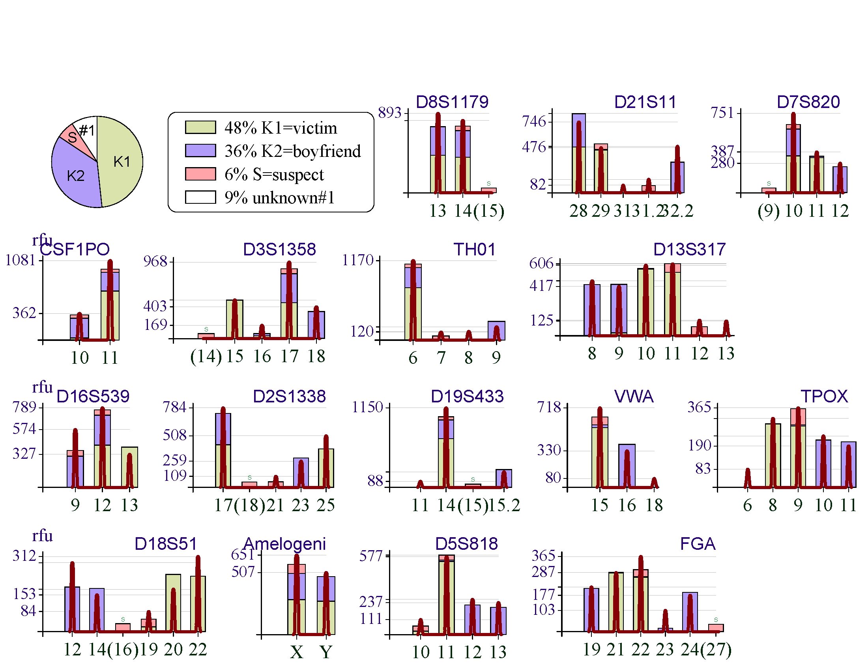
Prosecuting S: claim K1,K2,S in mixture
max likelihood proportions
K2 K1
S
Definitely need 4th contributor

Slide 9
Likelihood Ratios (LRs)
 |  | Defense (of S) hypotheses
 | LR Hp/Hd | K1,K2&1unk (3 pers) | K1,K2&2unk (4 pers) | K1,K2&0unk (2 pers)
Prosecution hypotheses | K1,K2,S&1unk (4 pers) | 2 | 120 | 10⁴⁵
 | K1,K2,S&0unk (3 pers) | 10⁻²¹ | 10⁻²⁰ | 10²⁴
!
That’s LR=10²¹ favoring defense!
Notes:
# contributors matters. If insist on same number, which number?

Slide 10
# of contributors
“Expert” advice: Start by determining the number of contributors!
Why is this a problem?
  How can we know the number?
  What’s a “contributor” anyway?
Notes:
“Expert” advice: Start by determining the number of contributors!

Slide 11

Rethinking “contributor”
What is a contributor?
  One DNA molecule donated? Amplified?
  Source of one fluorescence photon?
  Not operationally useful
  Source of “significant” fluorescence?
  Not well-defined
Conclusion: “# of contributors” isn’t a clear concept,
  therefore nonsense to insist it be same for prosecution & defense hypotheses.
  Besides – who would get to decide
?

Slide 12
If no “contributor” or “# of contributors”, then what?
Calculation
  Do not begin by deciding # of contributors!
    Ignore the nice papers & programs for guessing “the” #.
  Computation does need a number.
  Try all different numbers; see what works best.
    (independently for H_{p} & H_{d})
    Difficult for MCMC methods.
    Automated in Mixture Solution™
Notes:
Simplify title to “what then?”

Slide 13

Wrapping up …
“Contributor” not definable.
  Prosecution/Defense # contributors needn’t jibe.
  not in theory, not in practice
  miscarriage of justice at risk
MCMC programs don’t cope
Counterexample moral:
  NOT “watch out for this particular situation”
  BUT: “same #s of contributors” theory is wrong.
Notes:
MCMC is a hindrance

Slide 14

charles@dna-view.com
http://dna-view.com
☎510 798 7139
The end
This work received no support from the NIJ, IMF, World Bank, Bill and Melinda Gates, or the Ford Foundation. Even Queen Isabella of Spain (usually a soft touch) wouldn’t pitch in.

